Slide 1
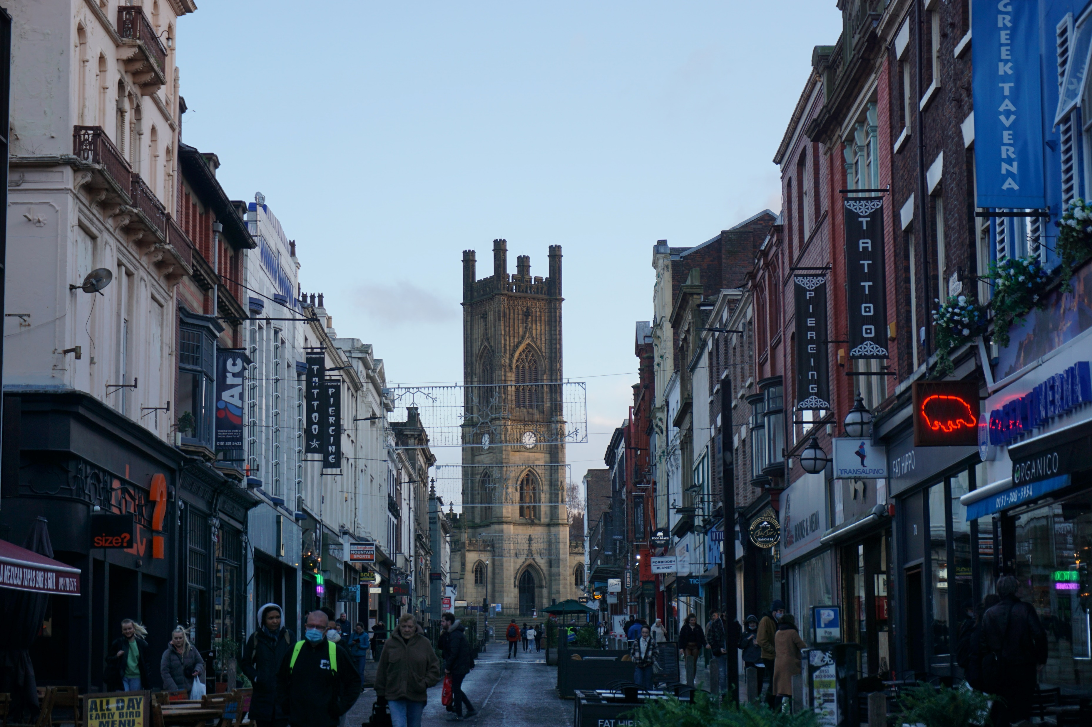





Evidence of structural, functional and spatial inequalities in the post-pandemic recovery British retail centres.
Patrick Ballantyne, Alex Singleton and Les Dolega
Notes:
Introduce this as the final piece of research from my PhD; a thesis that has focused on retail centres, retail centre geographies and COVID-19…
I am currently working through an early draft of this with my supervisors, so at a reasonably early stage with this…
Just a couple of acknowledgements to make before we begin:
- Thanks to Geolytix and the CDRC for the data, and agreeing to let me present findings from it
Cheers also to Cait, Rachael F and Francisco for setting up this session!
Looking forward to hearing what you all think?

Slide 2
Background
Data and Materials
Findings
Conclusions
Overview
Notes:
Overview of today’s presentation

Slide 3
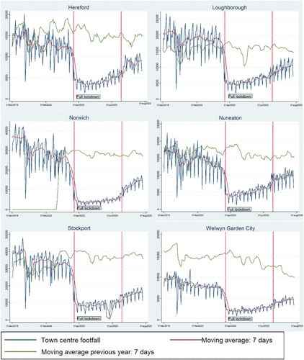
COVID-19 has, and continues to change the ways in which we shop (Sit et al., 2022)
Limited efforts to understand the response of retail centres “the primary sites of consumption in urban areas” (Dolega and Celinska-Janowicz, 2015)
How might we expect them to respond:
Function
Structure
Geographic location
Omicron (Nov 2021 – present)
Ballantyne et al. (2021) A framework for delineating the scale, extent and characteristics of American retail centre agglomerations. Environment and Planning B: Urban Analytics and City Science.
Enoch et al. (2022) When COVID-19 came to town: Measuring the impact of the coronavirus pandemic on footfall on six high streets in England. Environment and Planning B: Urban Analytics and City Science.
Background
Data: Public Health England (2022)
Notes:
[CLICK]
Probably don’t need to tell you that COVID-19 has impacted retail; trends including the split between essential vs non-essential, stockpiling and panic buying, significant impacts on leisure retailers in earlier phases.
[CLICK]
But these trends have wider impacts, particularly on the places in which we shop; retail centres.
Retail centres can be thought of a ‘the primary sites of consumption in urban areas’; encompass everything from your traditional high street, to a large shopping centre
Some research has emerged examining the response of sites of consumption to early waves of the pandemic (examples in the UK and US)…
[CLICK]
Often these papers identify functional, structural and spatial differences in these responses;
Function: the role of the retail centre, whether it’s a local neighbourhood centre or a large regional city centre
Structural: the intrinsic characteristics of the centre, whether it exhibits high levels of vacancies, the profile of consumers in the catchment
Spatial: differences between different areas, N vs S, regional differences etc.
[CLICK]
But nothing has been done about this in terms of Omicron
Omicron background:
Why Omicron matters:

Slide 4
Background
Data and Materials
Findings
Conclusions
Overview
Notes:
Overview of today’s presentation

Slide 5
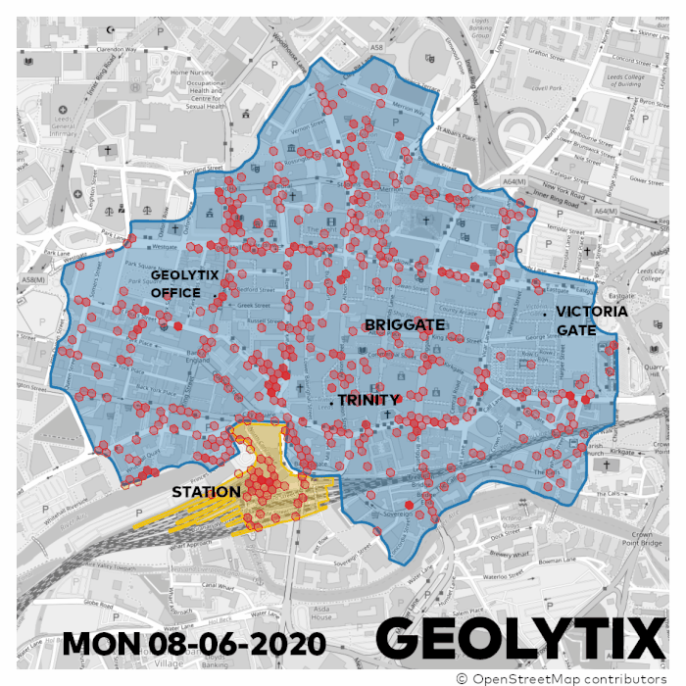
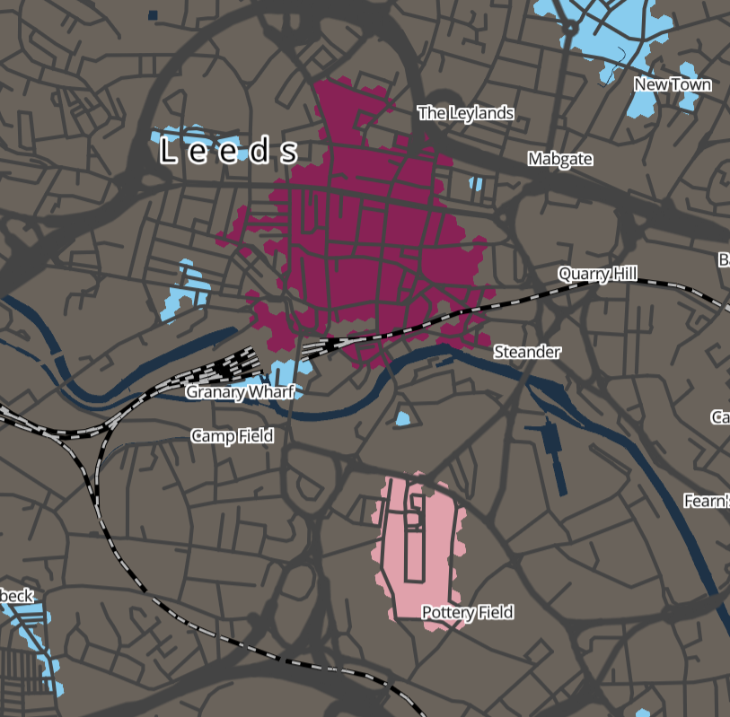
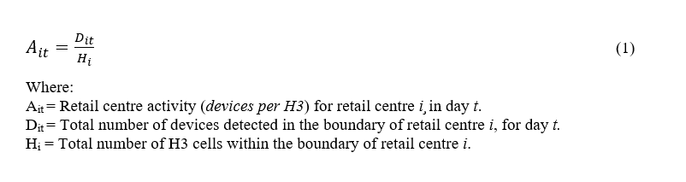
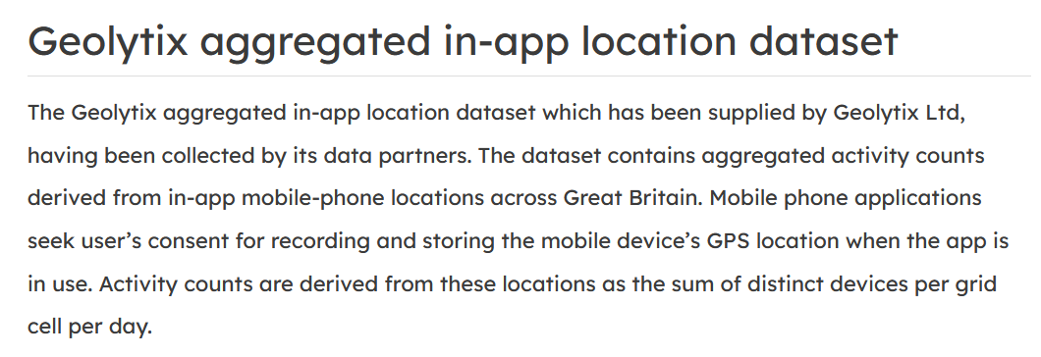
Data and Materials
Notes:
First I’m going to talk to you about the data we are using in this paper…
[CLICK]
This is the Geolytix aggregated in-app location dataset; hourly counts of activity within H3 cells for the extent of the UK, based on unique devices detected within each cell.
But the question I had to try and solve was how could we convert this high spatio-temporal mobility dataset into a robust performance indicator for the retail centres…
[CLICK]
This is our approach, we take an daily measure of average activity, that accounts for individual activity within each H3 cell, and the size of the retail centre itself, in effect devices per H3

Slide 6
What is the retail centre’s function?
What about it’s structure and catchment?
Data and Materials (2)
Notes:
And how might we go about assessing how retail centres with different function and structure have responded to the pandemic
[CLICK]
Well for function we have a retail centre hierarchy; each centre is assigned a functional role and we can look at differences between these
[CLICK]
For structure, we have a number of indicators for the retail centres, so we can look at differences in response between centres of differing structural characteristics.

Slide 7
Background
Data and Materials
Findings
Conclusions
Overview
Notes:
Overview of today’s presentation

Slide 8
Retail centres and Omicron
Notes:
So here we have changes in daily COVID-19 cases and daily retail centre activity (national level)…
In terms of Omicron, notice the spike in cases in relation to the first two subvariants of Omicron, but not as much so for BA.4 and BA.5; free testing removed as of April 1st.
BA.1: Ait fell around 60% from Nov 2021 by Jan 2022, came at a time where Plan B was introduced… Although Plan B had limited restrictions, so reduced activity was more about perceptions of risk likely…
BA.2: Ait had recovered slightly by late February of this year, however fell again in response to BA.2, no restriction whatsoever?
BA.4/BA.5, falling again, no restrictions, cost of living crisis (a period where inflation continued to risk, petrol prices.
Reduced activity 12 months on demonstrates significant consequences for the long-term sustainability of retail centres.

Slide 9
The functional response of retail centres
Notes:
How did retail centres of different types respond during this time then?
Well firstly, noticeable hierarchical structure of activity between the different types; larger centres more average activity, despite a measure controlling for this. Interesting example are district centres; higher activity despite being smaller than lots, fastest to recover in pandemic…
The general trend of declining activity overall, and in response to Omicron subvariants is particularly apparent here…
Most pronounced response seen for regional centres; fall from a much higher value, 50-60% decline in response to Omicron
However, all other types also experience significant decreases, Omicron does not differentiate!!

Slide 10
The functional response of retail centres (2)
Notes:
Surprisingly, all regions exhibited roughly the same trends…
Retail centres in London appear to have faced greater impacts; regional centres fell by 60%, other types fell by around 50%... Whereas in regions like the North West, Wales and the North East, the response of non-regional centres was much less severe!
This is interesting; lots written about London in early pandemic as people moved out of the city for better housing etc., trends still evident now!

Slide 11
The structural response of retail centres
Notes:
To investigate structural response, we split these distributions in two by taking the top and bottom 10% of each indicator, a subset of which can be seen here…
Obvious trend is that all seem to fall the same pattern seen with previous graphs regardless of the structural indicator in question…
However, when examining differences between centres characterised with high and low values, the trend varies…
Leisure; centres with highest provision of leisure exhibit 3x as much activity, falling by 66% in comparison to 38%.
Structural vacancies; lower values of structural vacancies exhibit higher activity in general, although both seem to experience similar responses.
Deprivation of the catchment; no obvious differences, similar levels of average activity regardless of deprivation.

Slide 12
Background
Data and Materials
Findings
Conclusions
Overview
Notes:
Overview of today’s presentation

Slide 13

Explored the functional, structural and spatial response of retail centres to Omicron
Significant implications for the viability and vitality of consumption spaces:
Regional centres
Struggling centres, leisure-orientated, deprivation
London
Data: Geolytix in-app aggregation location dataset
Merits
Limitations
Research trajectory…
Response prediction (short-term, longer-term)
Targeting inequality; access to vibrant consumption spaces
Conclusions
Notes:
[CLICK]
Explored retail centre response to Omicron, for the first time… First time doing a national scale response study, and first time looking away from ‘height’ of the pandemic
[CLICK]
Implications for certain types of centres, and those with specific structural characteristics
[CLICK]
Merits: robust economic performance indicator, better than footfall as does not privilege location, consistent time period
Drawbacks: mobility data is subject to its own limitations, stable sample of devices, more sophisticated methods
[CLICK]
Lots of potential to use this to investigate the longer-term consequences of the pandemic; will activity ever really rebound, integrating with a mobility dataset before Omicron to assess short-term impacts of Omicron
Targeting inequality; everyone deserves a vibrant place to shop!

Slide 14
Evidence of structural, functional and spatial inequalities in the post-pandemic recovery British retail centres.
Patrick Ballantyne, Alex Singleton and Les Dolega
Notes:
Introduce this as the final piece of research from my PhD; a thesis that has focused on retail centres, retail centre geographies and COVID-19…
I am currently working through an early draft of this with my supervisors, so at a reasonably early stage with this…
Just a couple of acknowledgements to make before we begin:
- Thanks to Geolytix and the CDRC for the data, and agreeing to let me present findings from it
Cheers also to Cait, Rachael F and Francisco for setting up this session!
Looking forward to hearing what you all think?

